Slide 1


Git & GitHub

Slide 2
What is Version Control System ?
Version Control System are a category of software tools that helps in recording changes made to files by keeping a track of modifications done in a code.
It is also known as source control or revision control.

Slide 3
What is the use of version control ?
As organizations accelerate delivery of their software solutions through DevOps, controlling and managing different versions of application artifacts — from code to configuration and from design to deployment — becomes increasingly difficult.
Version control software facilitates coordination, sharing, and collaboration across the entire software development team. It enables teams to work in distributed and asynchronous environments, manage changes and versions of code and artifacts, and resolve merge conflicts and related anomalies.

Slide 4
Benefits of version control
Managing and Protecting the source code.
Keep track of all the modifications made to the code.
Comparing earlier versions of code.
Support the developers workflow and not any rigid way of working.

Slide 5
Types of version control systems ?
The two most popular types are centralized and distributed.
Centralized version control systems store all the files in a central repository, while distributed version control systems store files across multiple repositories.
Other less common types include lock-based and optimistic.

Slide 6
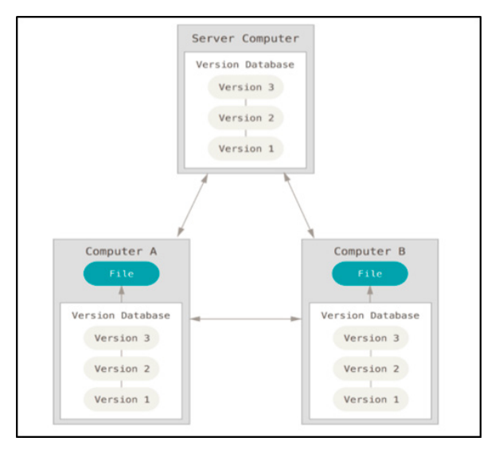
Distributed Version Control System
A distributed version control system (DVCS) allows users to access a repository from multiple locations. DVCSs are often used by developers who need to work on projects from multiple computers or who need to collaborate with other developers remotely.
Ex : Git, Mercurial, Bazaar or Darcs.

Slide 7
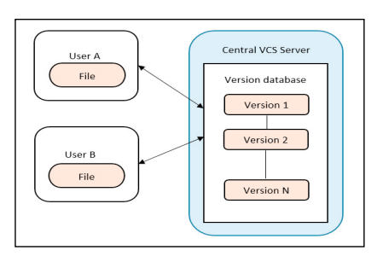
Centralized Version Control System
A centralized version control system (CVCS) is a type of VCS where all users are working with the same central repository. This central repository can be located on a server or on a developer's local machine. Centralized version control systems are typically used in software development projects where a team of developers needs to share code and track changes.
Ex : CVS, Sub Version, Perforce.

Slide 8
Keywords
Git directory - Stores the metadata and object database for your project (while cloning the repository)
Working directory - Single checkout of one version of the project. The files in the directory are pulled out of the compressed database in the Git directory and placed on disk for you to edit and use.
Staging area - It is a simple file, generally present in your Git directory, that stores information about what will go into your next commit.
Fork - A fork is a new repository that shares code and visibility settings with in the original “upstream” repository.

Slide 9
Snapshot - It is a representation of the current state of your tracked files in the form of a manifest, which can be compared with other manifest, to see where the differences are. Git only tracks the differences between manifests from the first moment it was tracked.
Branches - It is a part of your everyday development process. Git branches are effectively a pointer to a snapshot of your changes.
Pull request - When you open a pull request, you’re proposing your changes and requesting that someone review and pull in your contribution and merge them into their branch. Pull requests show diffs, or differences, of the content from both branches. The changes, additions, and subtractions are shown in different colours.

Slide 10

Recording Changes to the Repository
Each file in your working directory can be in one of the following two states:
Tracked
Untracked

Slide 11
Checking the status of Your files
Untracked Files – Files in your working directory that are not present in your last snapshot and staging area.
Tracked Files – Files that are present in the last snapshot
Staging Modified Files – A File which is already tracked and has been modified in the working directory, but not yet staged.
Unstaging Modified Files – A File that is out of the staging area.

Slide 12
What is git ?
• Git is a free and open source distributed version control system designed to handle everything from small to very large projects with speed and efficiency.
• It was initially designed and developed by Linus Torvalds for linux kernel development.
• Now it is maintained by Junio Hamano.
• Every Git working directory contains a full-fledged repository with complete history and full revision tracking capabilities
• It is not dependent on network access or a central server.

Slide 13
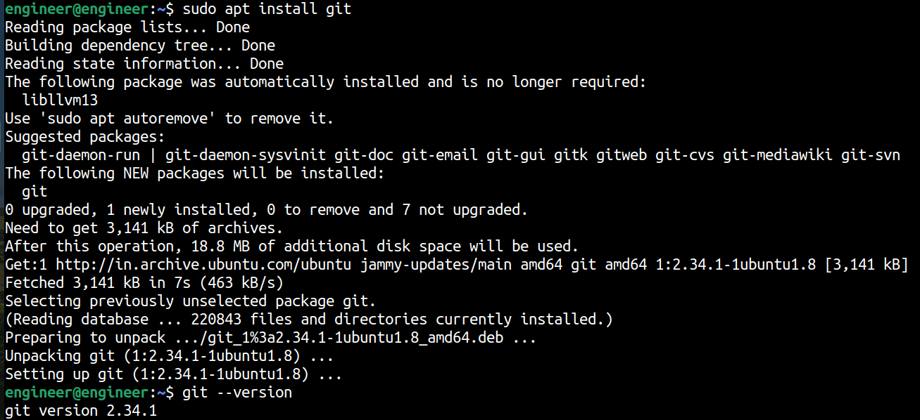
Basic git commands
To Install Git on your system by using
$ sudo apt install git

Slide 14
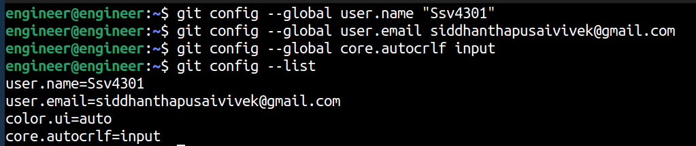
Git Configuration
We have to specify our name, email, line ending for that we have to use the following commands
$ git config --global user.name “your name”
$ git config --global user.email <your email>
$ git config --global core.autocrlf //for Windows it is true and for Linux it is input.
$ git config --list //to seen the user details

Slide 15
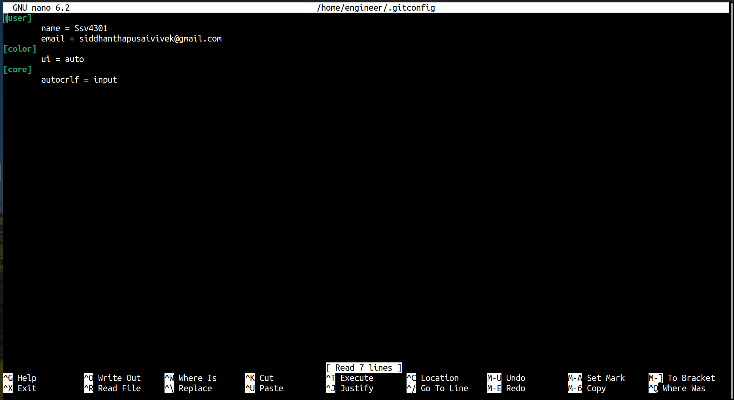
$ git config --global –e

Slide 16
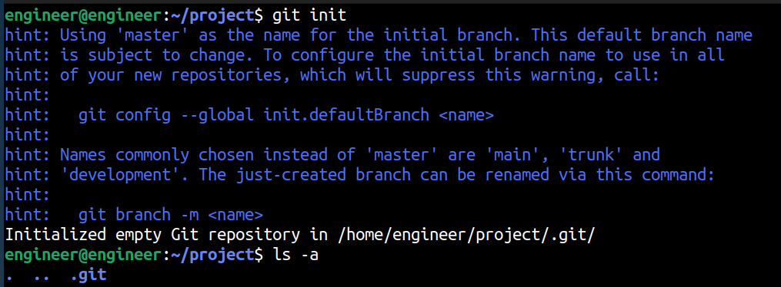
Initializing a repository
Create a directory on your system where you can edit and create all your projects.
Initialize a repository in this folder by using below command
$ git init
This command internally creates a directory named “.git” , where it stores all our project info in it like history ……..

Slide 17
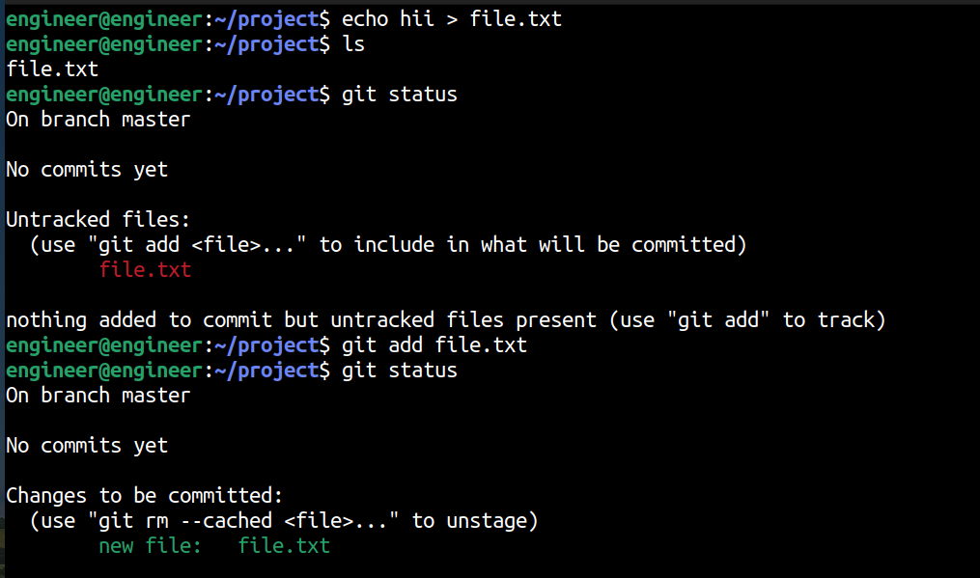
Adding files to repository (Staging area or index)
Create a project or open an existing project which you want to add in your repository.
After creating the project or making changes in the project we have to add in to the repository for that we have to use the following command
$ git add <file name>
$ git add . (this command will add all the files present in that directory in to the repository)

Slide 18
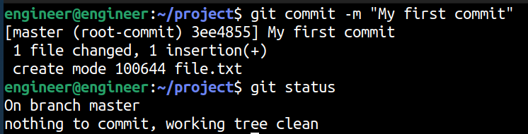
To update the status of file and others to know the status of file we have to use
$ git commit -m “your message”
If you want to know the status of your file we have to use below command
$ git status

Slide 19
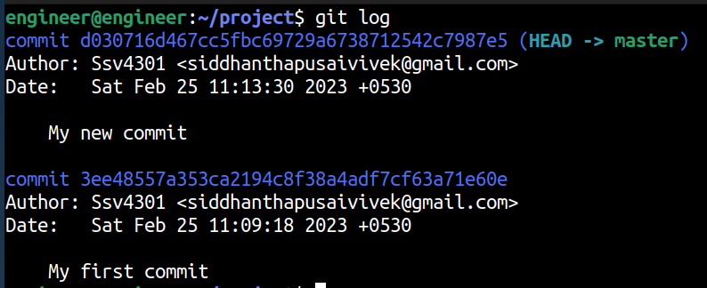
If you want to see the history we have to use below command
$ git log
$ git log --oneline
$ git log --oneline --reverse
$ git show ID
$ git show HEAD~linenumber

Slide 20

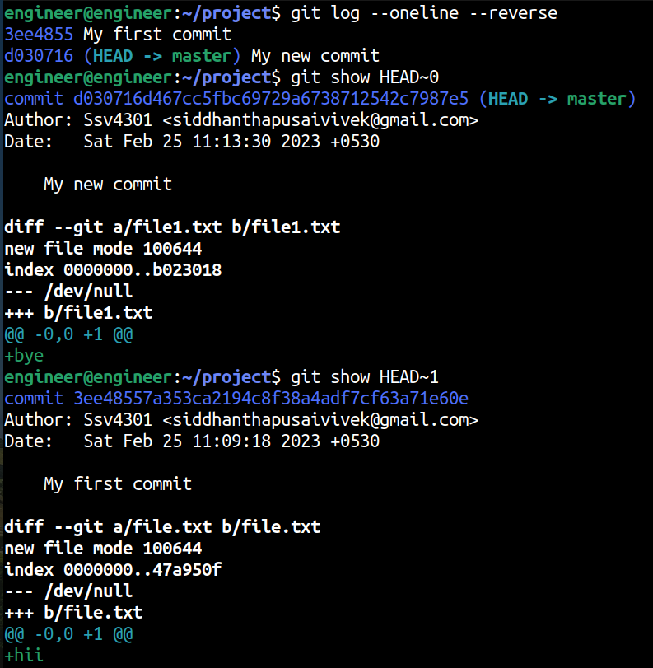

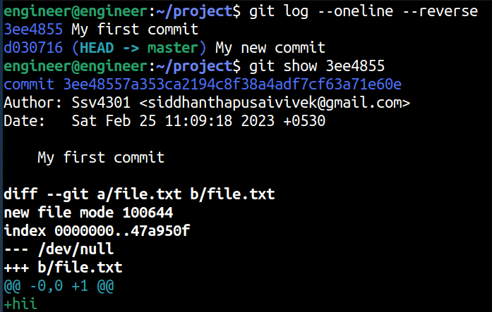

Slide 21
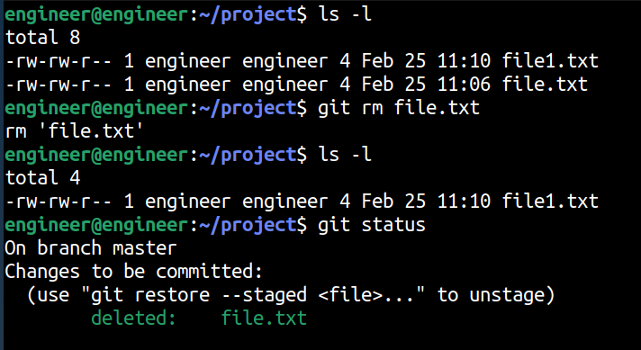
To remove the file
$ git rm filename
To remove the files from the stagging area
$ git rm --cached filename

Slide 22
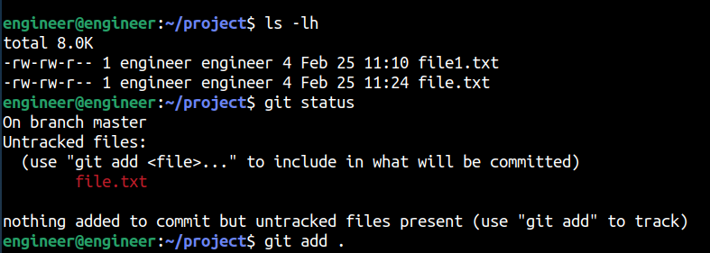
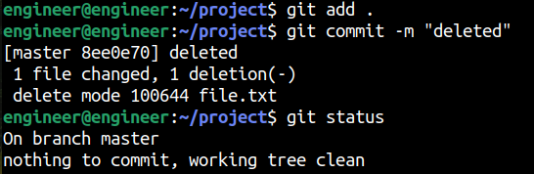
If you delete a file from the git directory but the file is present in the stagging area then you have to update the stagging area by using
$ git add file name
$ git commit –m “message”

Slide 23
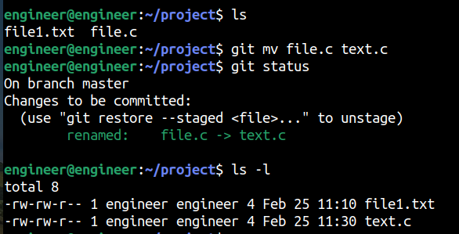
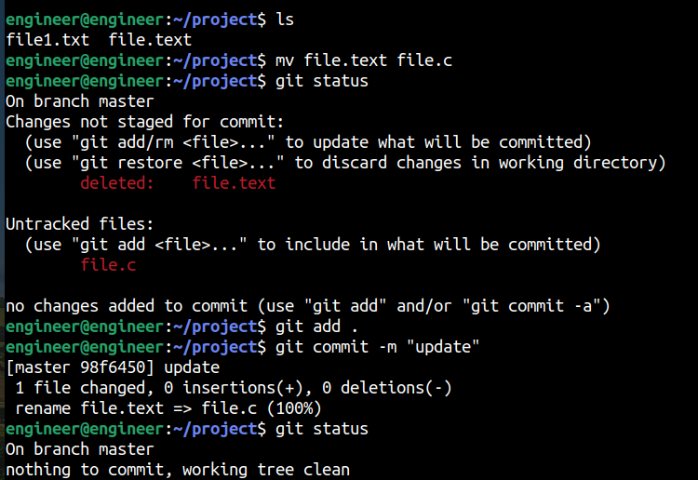
To rename a file in a git
$ git mv filename new filename
If you have changed the name of the file which is present in staging area then you have to update the staging area for that use
$ git add filename
$ git commit -m “message”

Slide 24
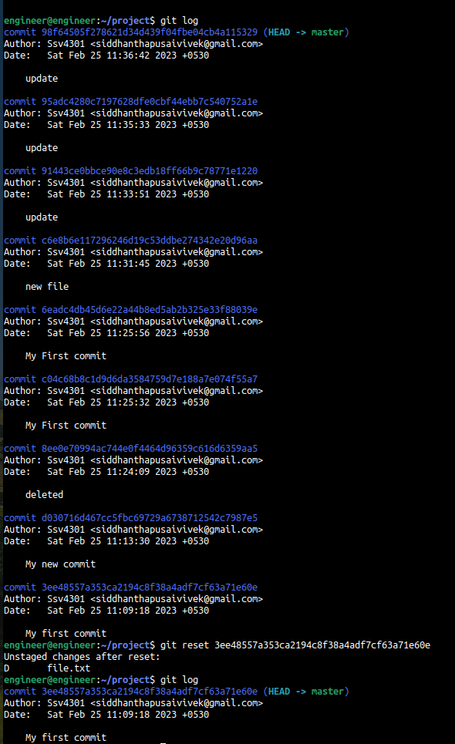
To make the staged file to unstaged file
$ git reset HEAD filename

Slide 25
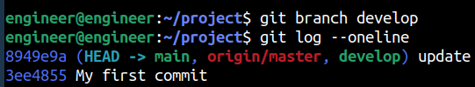
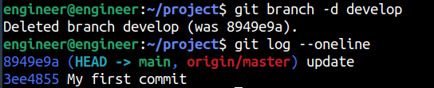
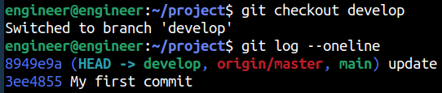
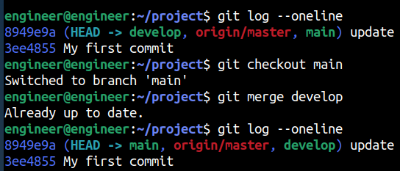
To create a branch in local repository
$ git branch <branch name>
To delete a branch in local repository
$ git branch –d <branch name>
To switch between branches use
$ git checkout <branch name>
To merge the branches use
$ git merge <branch name>

Slide 26
Git Hub
GitHub is a web-based Git repository hosting service, which offers all of the distributed revision control and source code management (SCM) functionality of Git as well as adding its own features.
To download and install the latest version of GitHub Desktop
https://desktop.github.com
Now open a new account or login into existing account.
Now we have to generate the token for that we have to go to settings in that select developer settings and go to personal access tokens in that select tokens(classic) and generate a new token.
In that set the expiry date to no expiration option and generate the token and save that key for later purpose.

Slide 27
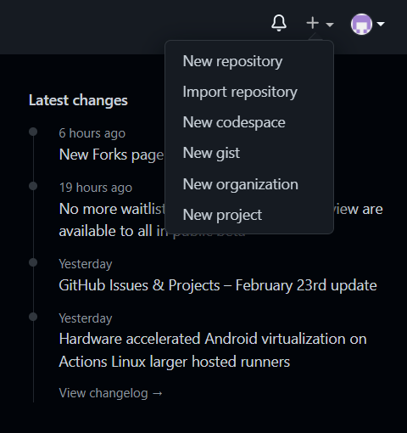
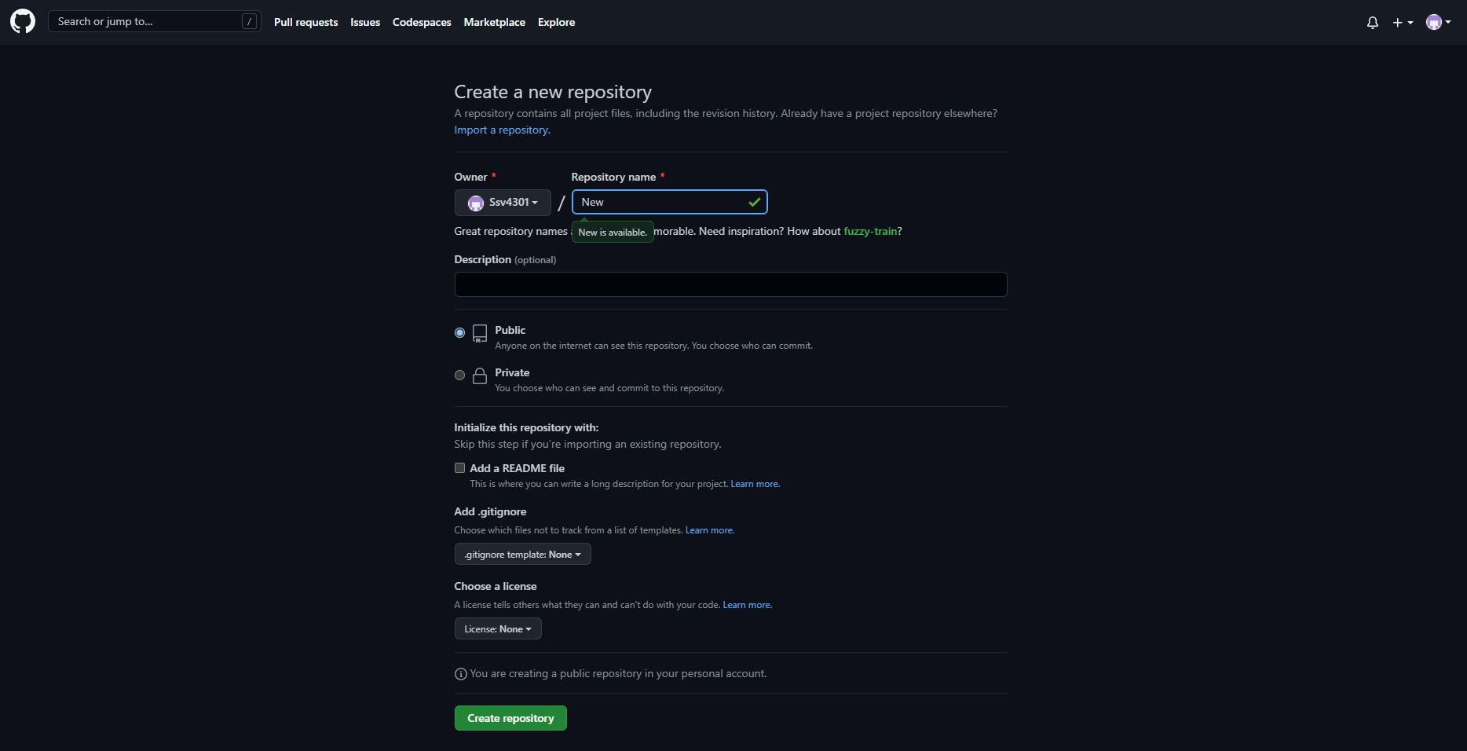
Creating a repository :
In the upper-right corner of any page, use the + drop down menu, and select New repository.
In the Repository name box, enter the name.

Slide 28
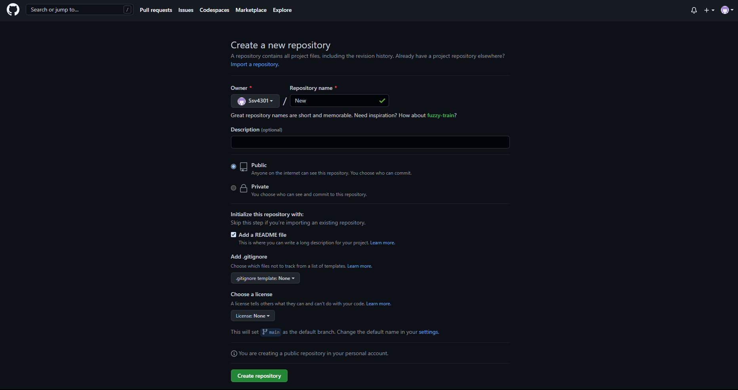
3. In the Description box, write a short description.
4. Select Add a README file.

Slide 29
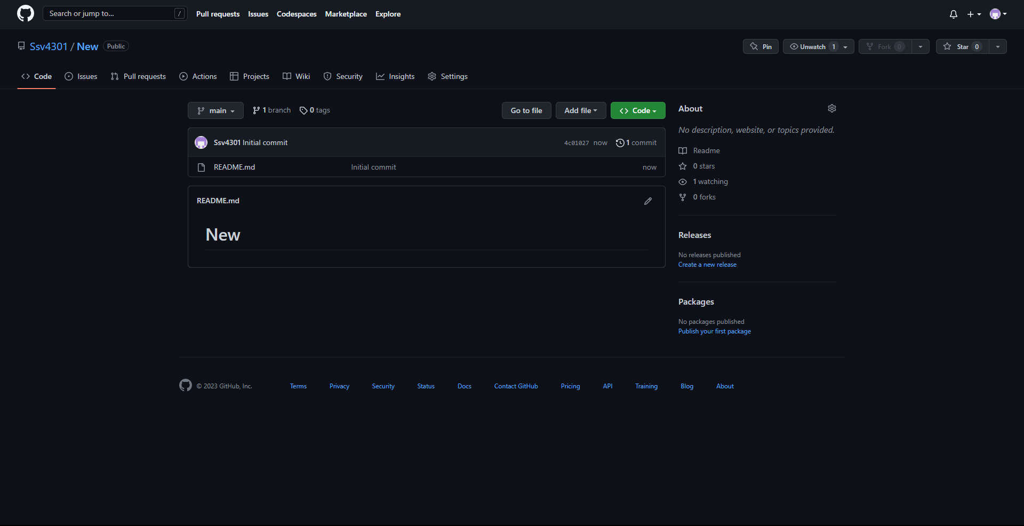
5. Select whether your repository will be Public or Private.
6. Click Create repository.

Slide 30
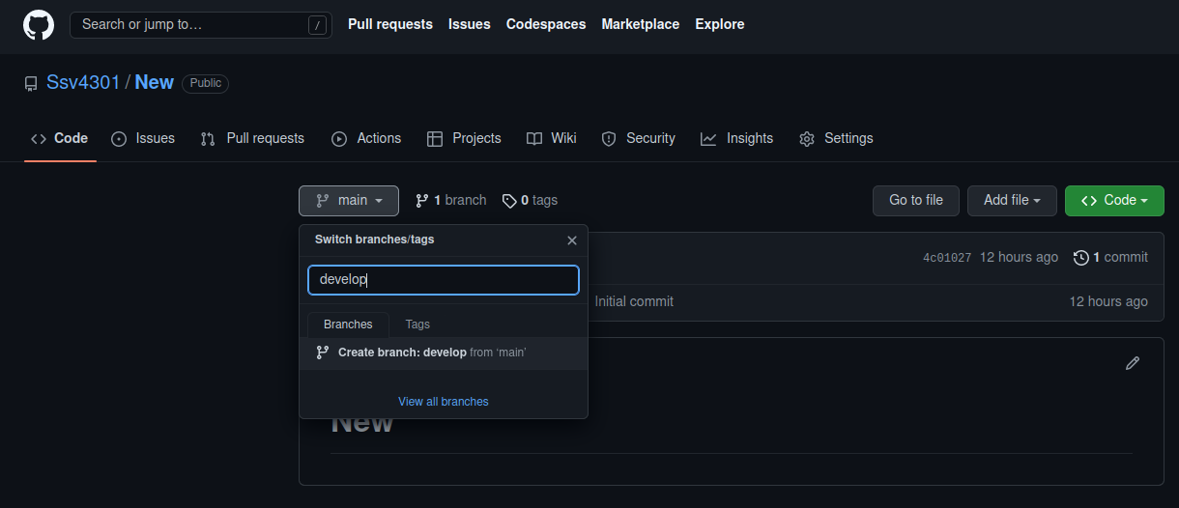
Creating a branch
Click the Code tab of your hello-world repository.
Above the file list, click the dropdown menu that says main.

Slide 31
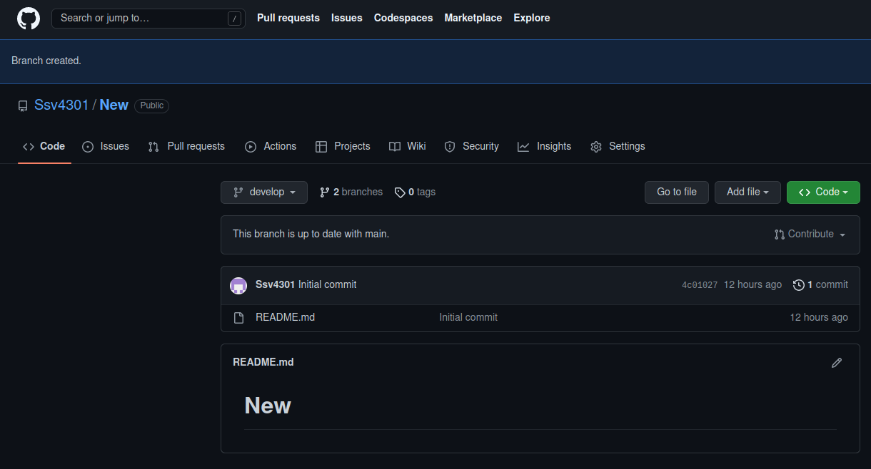
3. Type a branch name, readme-edits, into the text box.
4. Click Create branch : readme-edits from main.

Slide 32
Making and committing changes
Under the readme-edits branch you creates, click the README.md file.
Click to edit the file.
In the editor, write a bit about yourself. Try using different Markdown elements.
In the Commit changes box, write a commit message that describes your changes.
Click Commit changes.

Slide 33
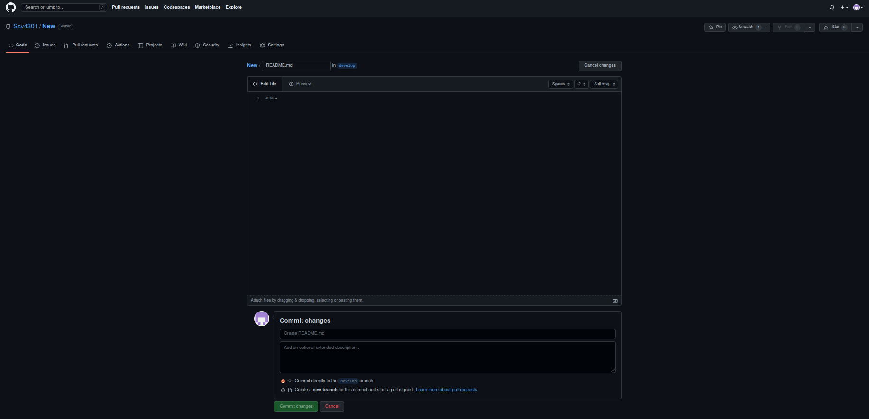

Slide 34
Opening a pull request
Click the Pull requests tab of your hello-world repository.
Click New pull request.
In the Example Comparisons box, select the branch you made, readme-edits, to compare with main (the original).
Look over your changes in the diffs on the Compare page, make sure they’re what you want to submit.

Slide 35
5. Click Create pull request.
6. Give your pull request a title and write a brief description of your changes. You can include emojis and drag and drop images and gifs.
7. Optionally, to the right of your title and description, click the settings next to Reviewers. Assignees , Labels, Project or Milestone to add any of these options to your pull request.
8. Click Create pull request

Slide 36
Merging your pull request
Click Merge pull request to merge the changes into main.
Click Confirm merge. You will receive a message that the request was successfully merged and the request was closed.
Click Delete branch. Now that your pull request is merged and your changes are on main, you can safely delete the readme-edits branch. If you want to make more changes to your project, you can always create a new branch and repeat this process.

Slide 37
How to push the files into the git hub ?
1. After creating or editing your file you have to add it to your git repository for that use
$ git add filename
$ git commit –m “Message”
2. Now we are remotely pushing our file from the git repository to git hub repository by using
$ git remote add origin <github repository url>
Note: If you have repository url directly paste it otherwise create new repository and copy its url and paste it hear.

Slide 38
3. Now we have to push our file into the github repository for that use
$ git push origin master
4. Now it will ask for you github username and password.
5. Here the password is the token what you have generated previously.
6. Now go to your github account and verify .

Slide 39
How to clone a repository from your github ?
1. If you want to get any repository from your github then use
$ git clone <url of the repository>
2. Now that repository is downloaded into your host machine , now you can make the changes what you want to do.
3. After creating or editing your file you have to add it to your git repository for that use
$ git add filename
$ git commit –m “Message”

Slide 40
4. Now we are remotely pushing our file from the git repository to github repository by using
$ git remote add origin <github repository url>
5. Now we have to push our file into the github repository for that use
$ git push origin master
6. Now it will ask for you github username and password.
7. Here the password is the token what you have generated previsouly.
8. Now go to your github account and verify .

Slide 41
How to create a branch and push it into the github ?
Firstly you have to create a branch by using
$ git branch <branch name>
Switch into that directory by using
$ git checkout <branch name>
Now create the files or edit the files under this branch.
After all the edits use
$ git push origin <branch name>
This will add a branch in your github repository , now to add the files you have to merge the branch with the main branch for that use
$ git checkout <main branch name> //this will take you to main branch
$ git merge <branch name> //this will link your newly created branch with main //branch
Note: To see main branch details use $ git log --oneline

Slide 42
Differences between Git and GitHub
Git
GitHub
Git is a software which was released in 2005 by Linus Torvalds.
Git is a command-line tool which can be installed locally on the system.
Git is maintained by Linux.
Git is focused on version control and code sharing.
Git is a open-source licensed
GitHub is a service which was launched in 2008.
GitHub is a graphical user interface which is hosted on web.
GitHub is maintained by Microsoft.
GitHub is a hosting service for git repositories.
GitHub includes a free-tier and pay-for-use tier.

